Slide 1
Review of
RGB-D face recognition under various conditions via 3D constrained local model
Nastaran Nourbakhsh Kaashki, Reza Safabakhsh 2018
Present by Mouqing
3/16/18

Slide 2
Background
A combination of 2D images (RGBs) and depth images (Ds) captured by Kinect has been used for the 3D face recognition in various conditions
CLM-Z model has been used to model and detect the important points of the face
The proposed method has better perform under illumination, expression and pitch pose conditions .

Slide 3
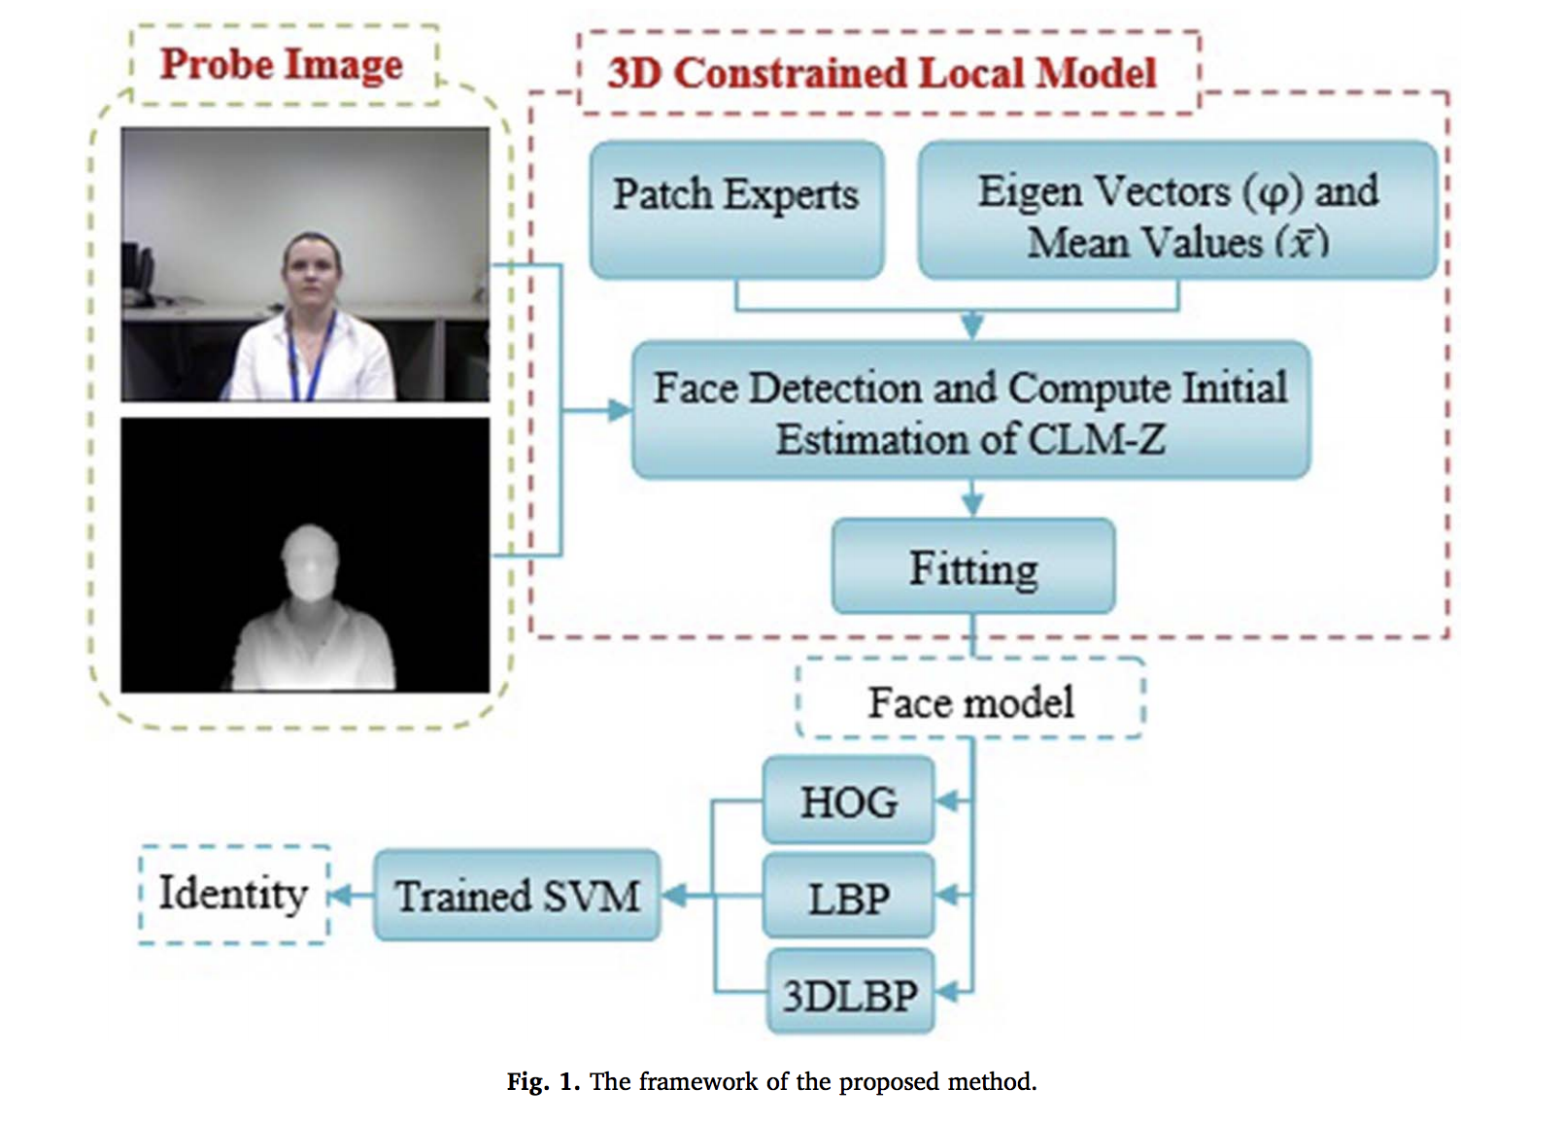
Frame work of the proposed method
detecting the face and smoothing the depth image
CLM-Z model has been used to model and detect the important points of the face
These points are described using Histogram of Oriented Gradients (HOG), Local Binary Patterns (LBP), and 3D Local Binary Patterns (3DLBP).
each face is recognized by a Support Vector Machine (SVM).

Slide 4
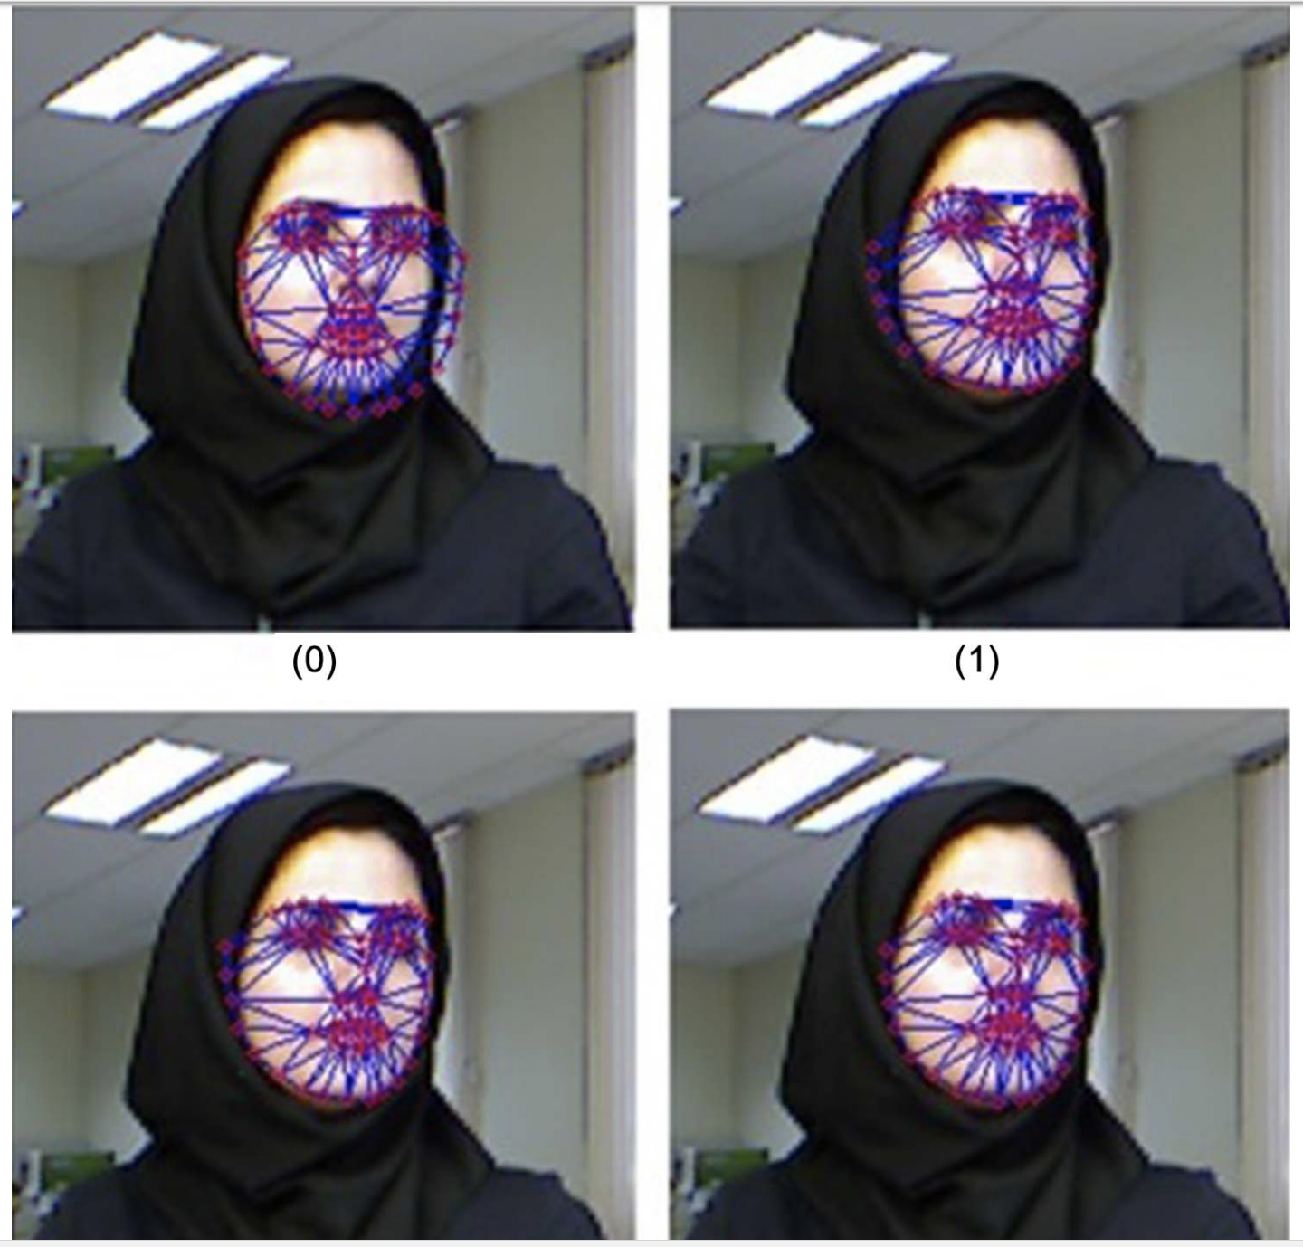
3D constrained local model(CLM-Z)
This model is represented with a Point Distribution Model (PDM)
There are 66 landmark in the CLM-Z model. A manually labeled dataset of faces is needed to train this model.
The angles accounted for the horizontal rotation of head are {0, ± 15, ± 30, ± 45, ± 60, ± 75} and the angles for vertical rotation are {± 0, ± 30, ± 60} . Separate SVM classifiers are trained for intensity and depth images

Slide 5
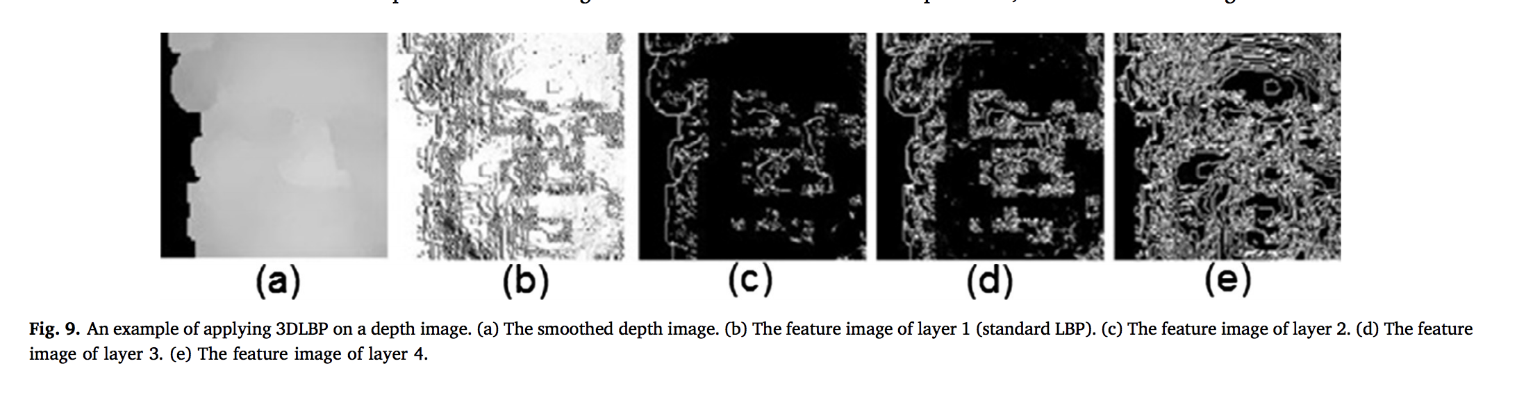
Feature extraction
using Histogram of Gradients (HOG)
Feature extraction using Local Binary Patterns (LBP) and 3D Local Binary Patterns (3DLBP)
A generalization of LBP which preserve the magnitude of difference is 3D Local Binary Pattern (3DLBP)

Slide 6
Training part
In the face recognition problem, the face feature vector is an input sample and the face identity is the sample label. Thus, the number of classes is equal to the number of persons present in the dataset. The trained SVM is used to determine the face identity of a test image.

Slide 7
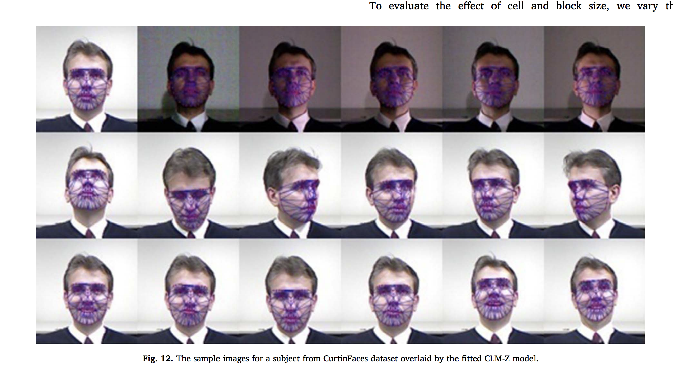
Experiment Results

Slide 8
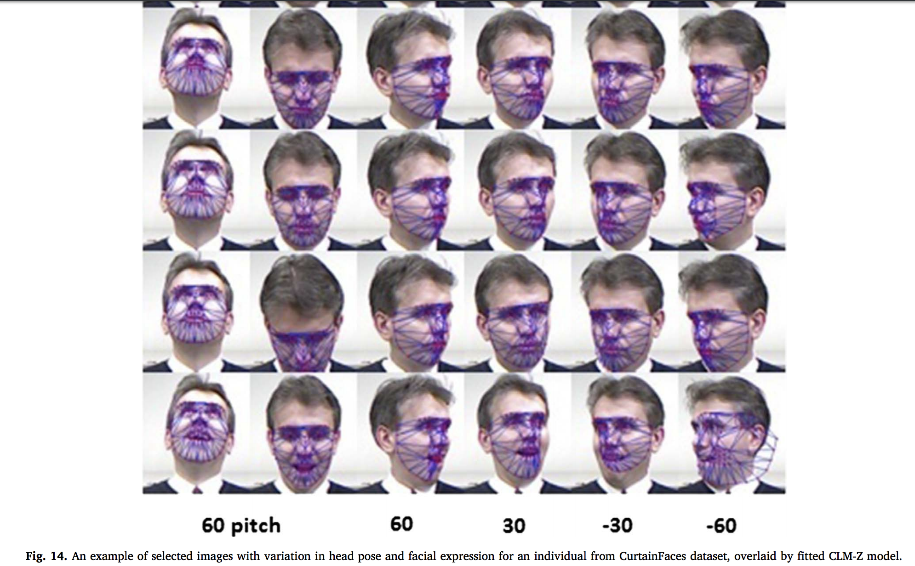
Experiment Results

Slide 9
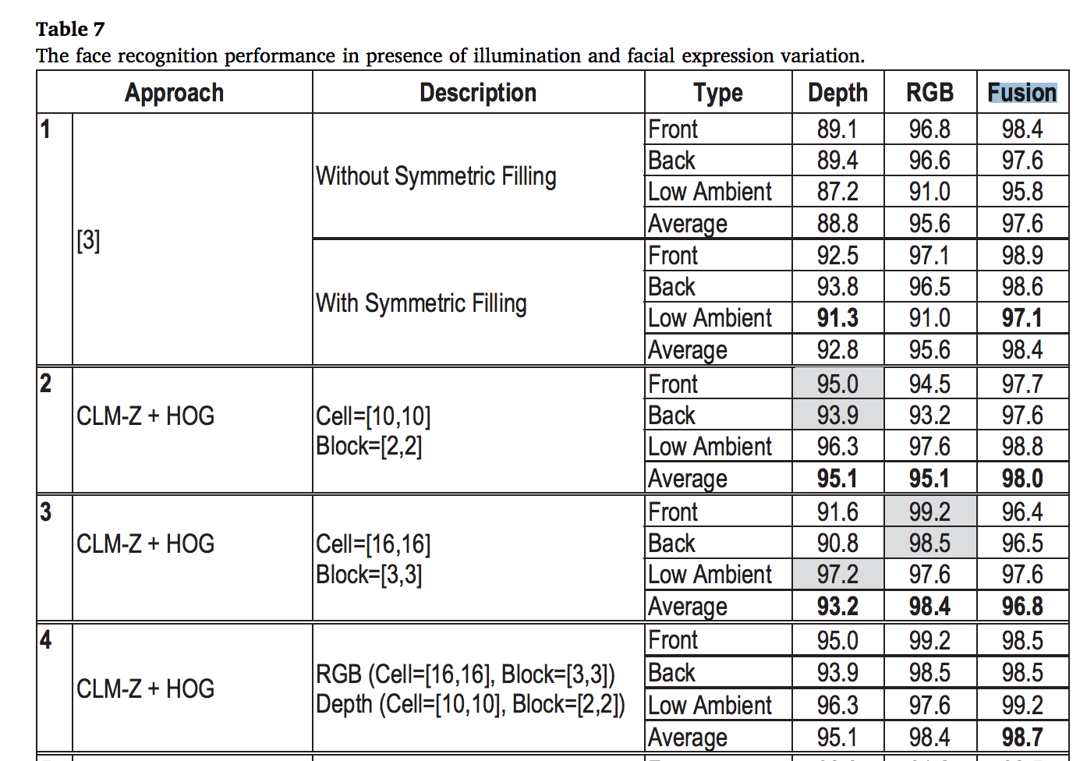
Experiment Results

Slide 10
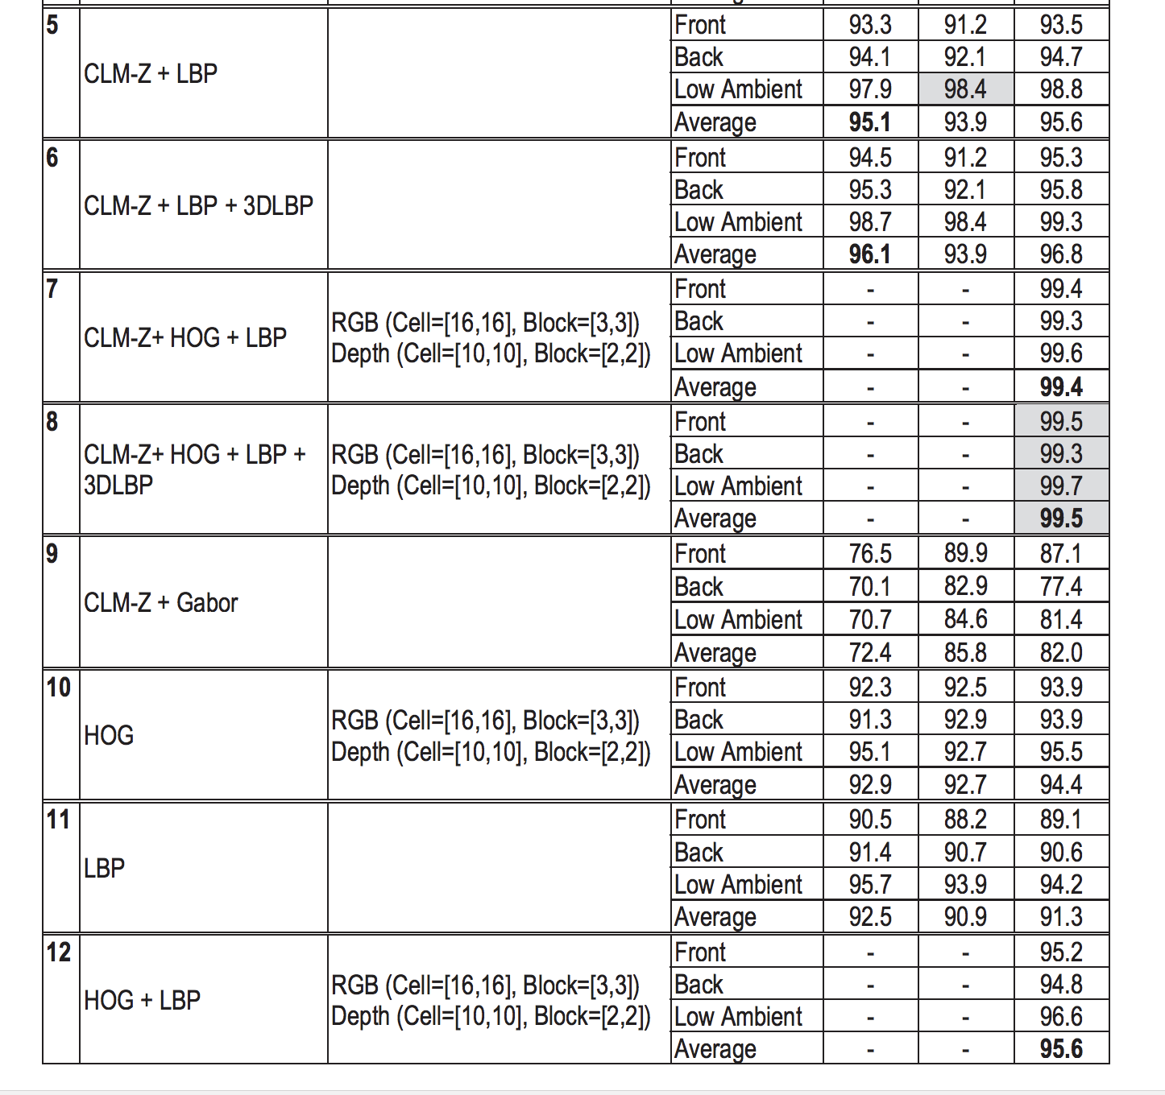
Experiment Results

Slide 11
Thanks!

